Slide 1
Technical Brief:
Rollershark_{tm}
Web Guides with Selectively Protruding Fins
UP Patent 12,595,147 B2

Slide 2

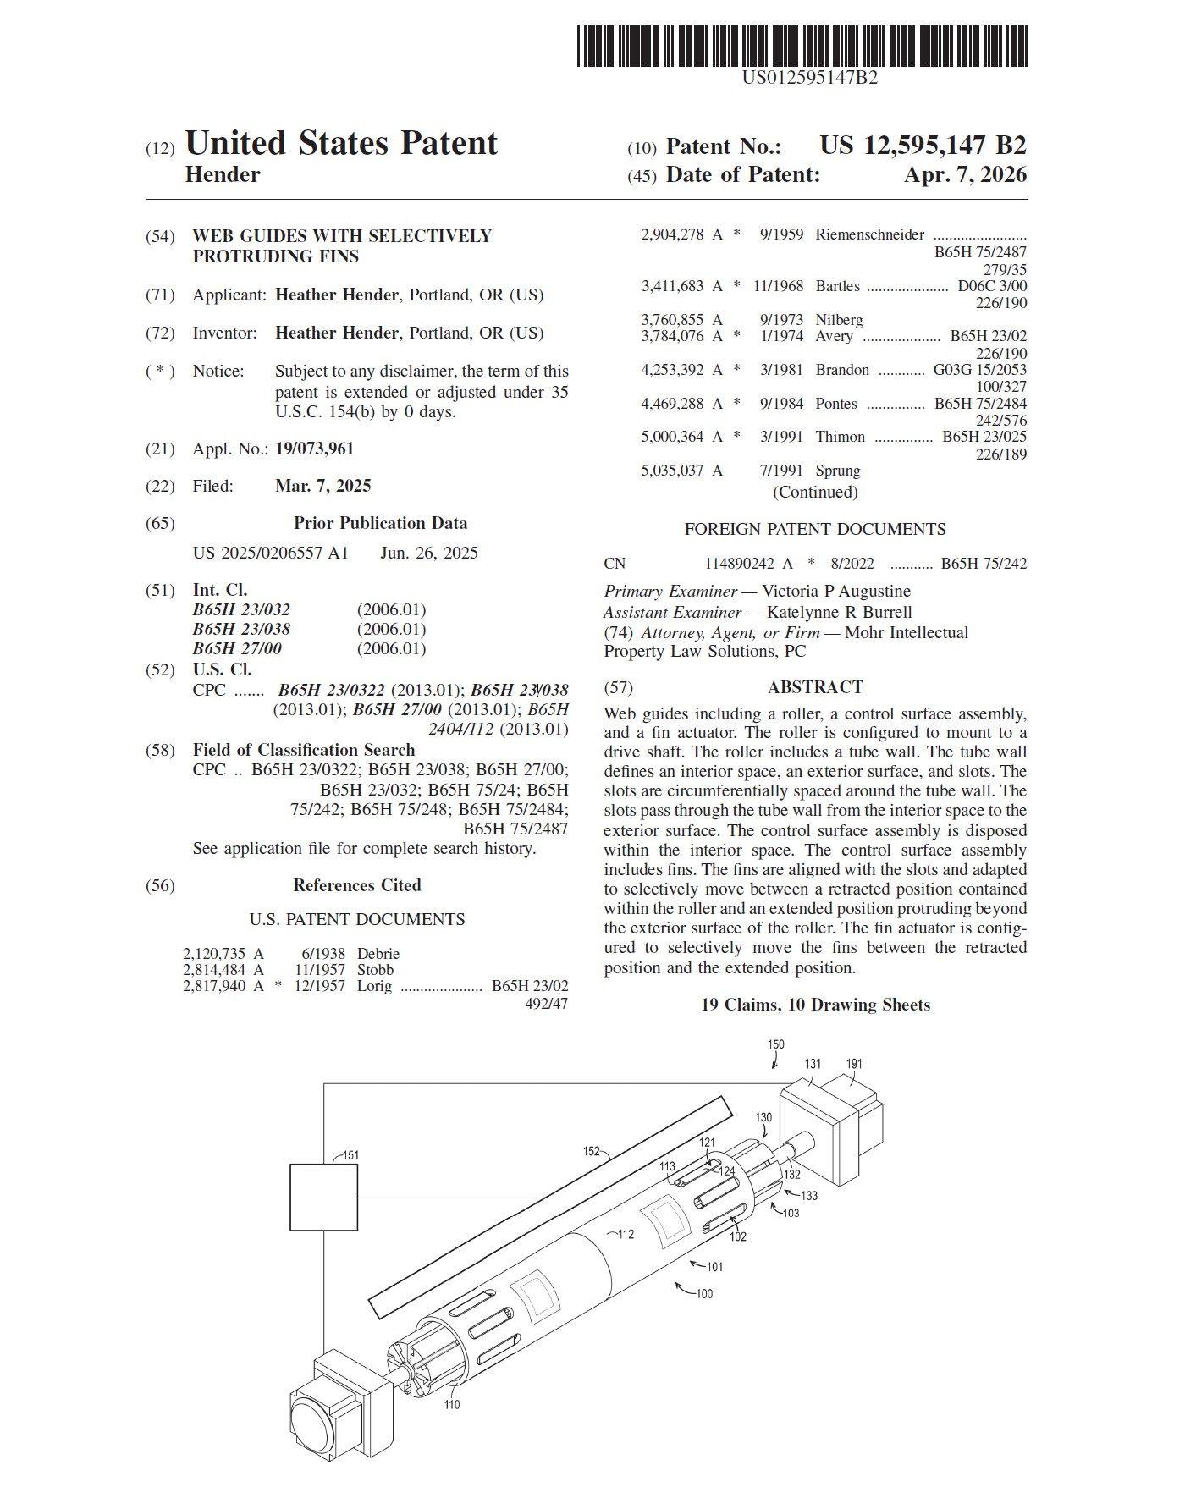
Patent Status
Granted US Patent 12595147 B2
CIP application filed
PCT application filed
Associated Patent (unpublished)
  Application filed
  CIP application reserved

Slide 3
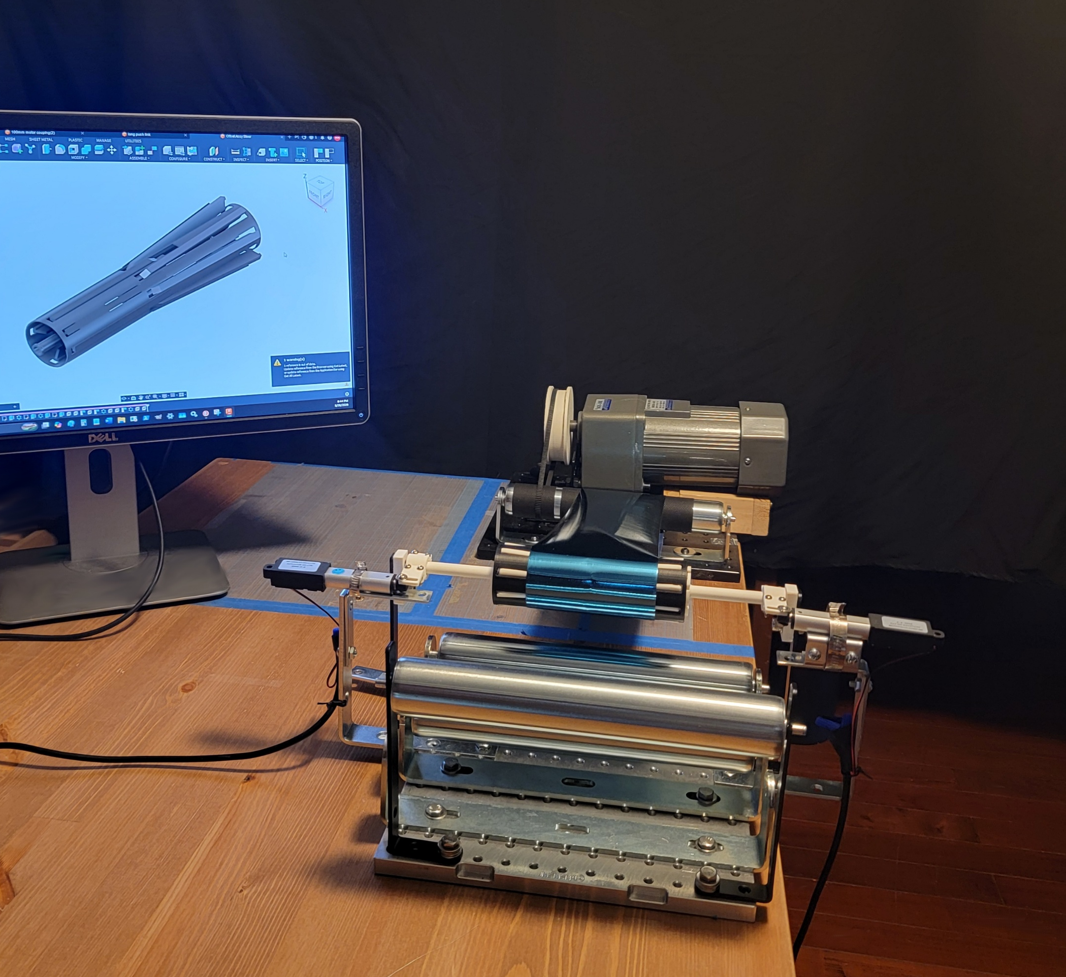
Technical Readiness Level (TRL)
The invention has been validated through a proof‑of‑concept prototype, demonstrating:
- Functional fin extension and retraction
- Actuation through a cam or linear mechanism
Consistent interaction with a moving web
Prototype Video available here
IP Strength & Freedom‑to‑Operate
A preliminary FTO‑style search shows:
- No prior patents with similar fin‑based roller mechanisms
- No conflicting claims in adjacent CPC classes
- A unique mechanical approach not found in traditional web guides

Slide 4
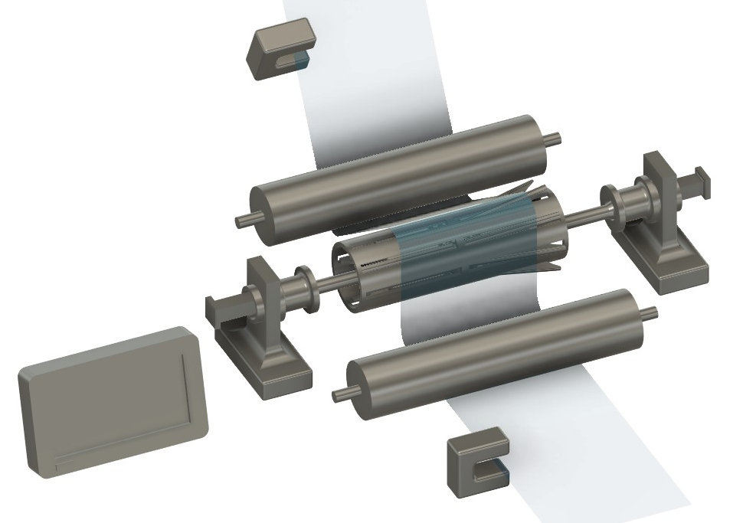
Manufacturability
All components can be produced using conventional industrial processes:
- CNC machining
- Laser cutting for slots
- Standard bearings and shafts
- Off‑the‑shelf actuators
- Widely available electronic components
No exotic materials or specialized tooling are required.
Core Mechanism Stability
The system uses simple, robust mechanical elements:
- A tubular roller with circumferential slots
- Internal fins that protrude only when actuated
- A cam or lever-style actuator for controlled movement
These components rely on standard manufacturing methods (machining, tube cutting, cam fabrication), minimizing production risk.

Slide 5
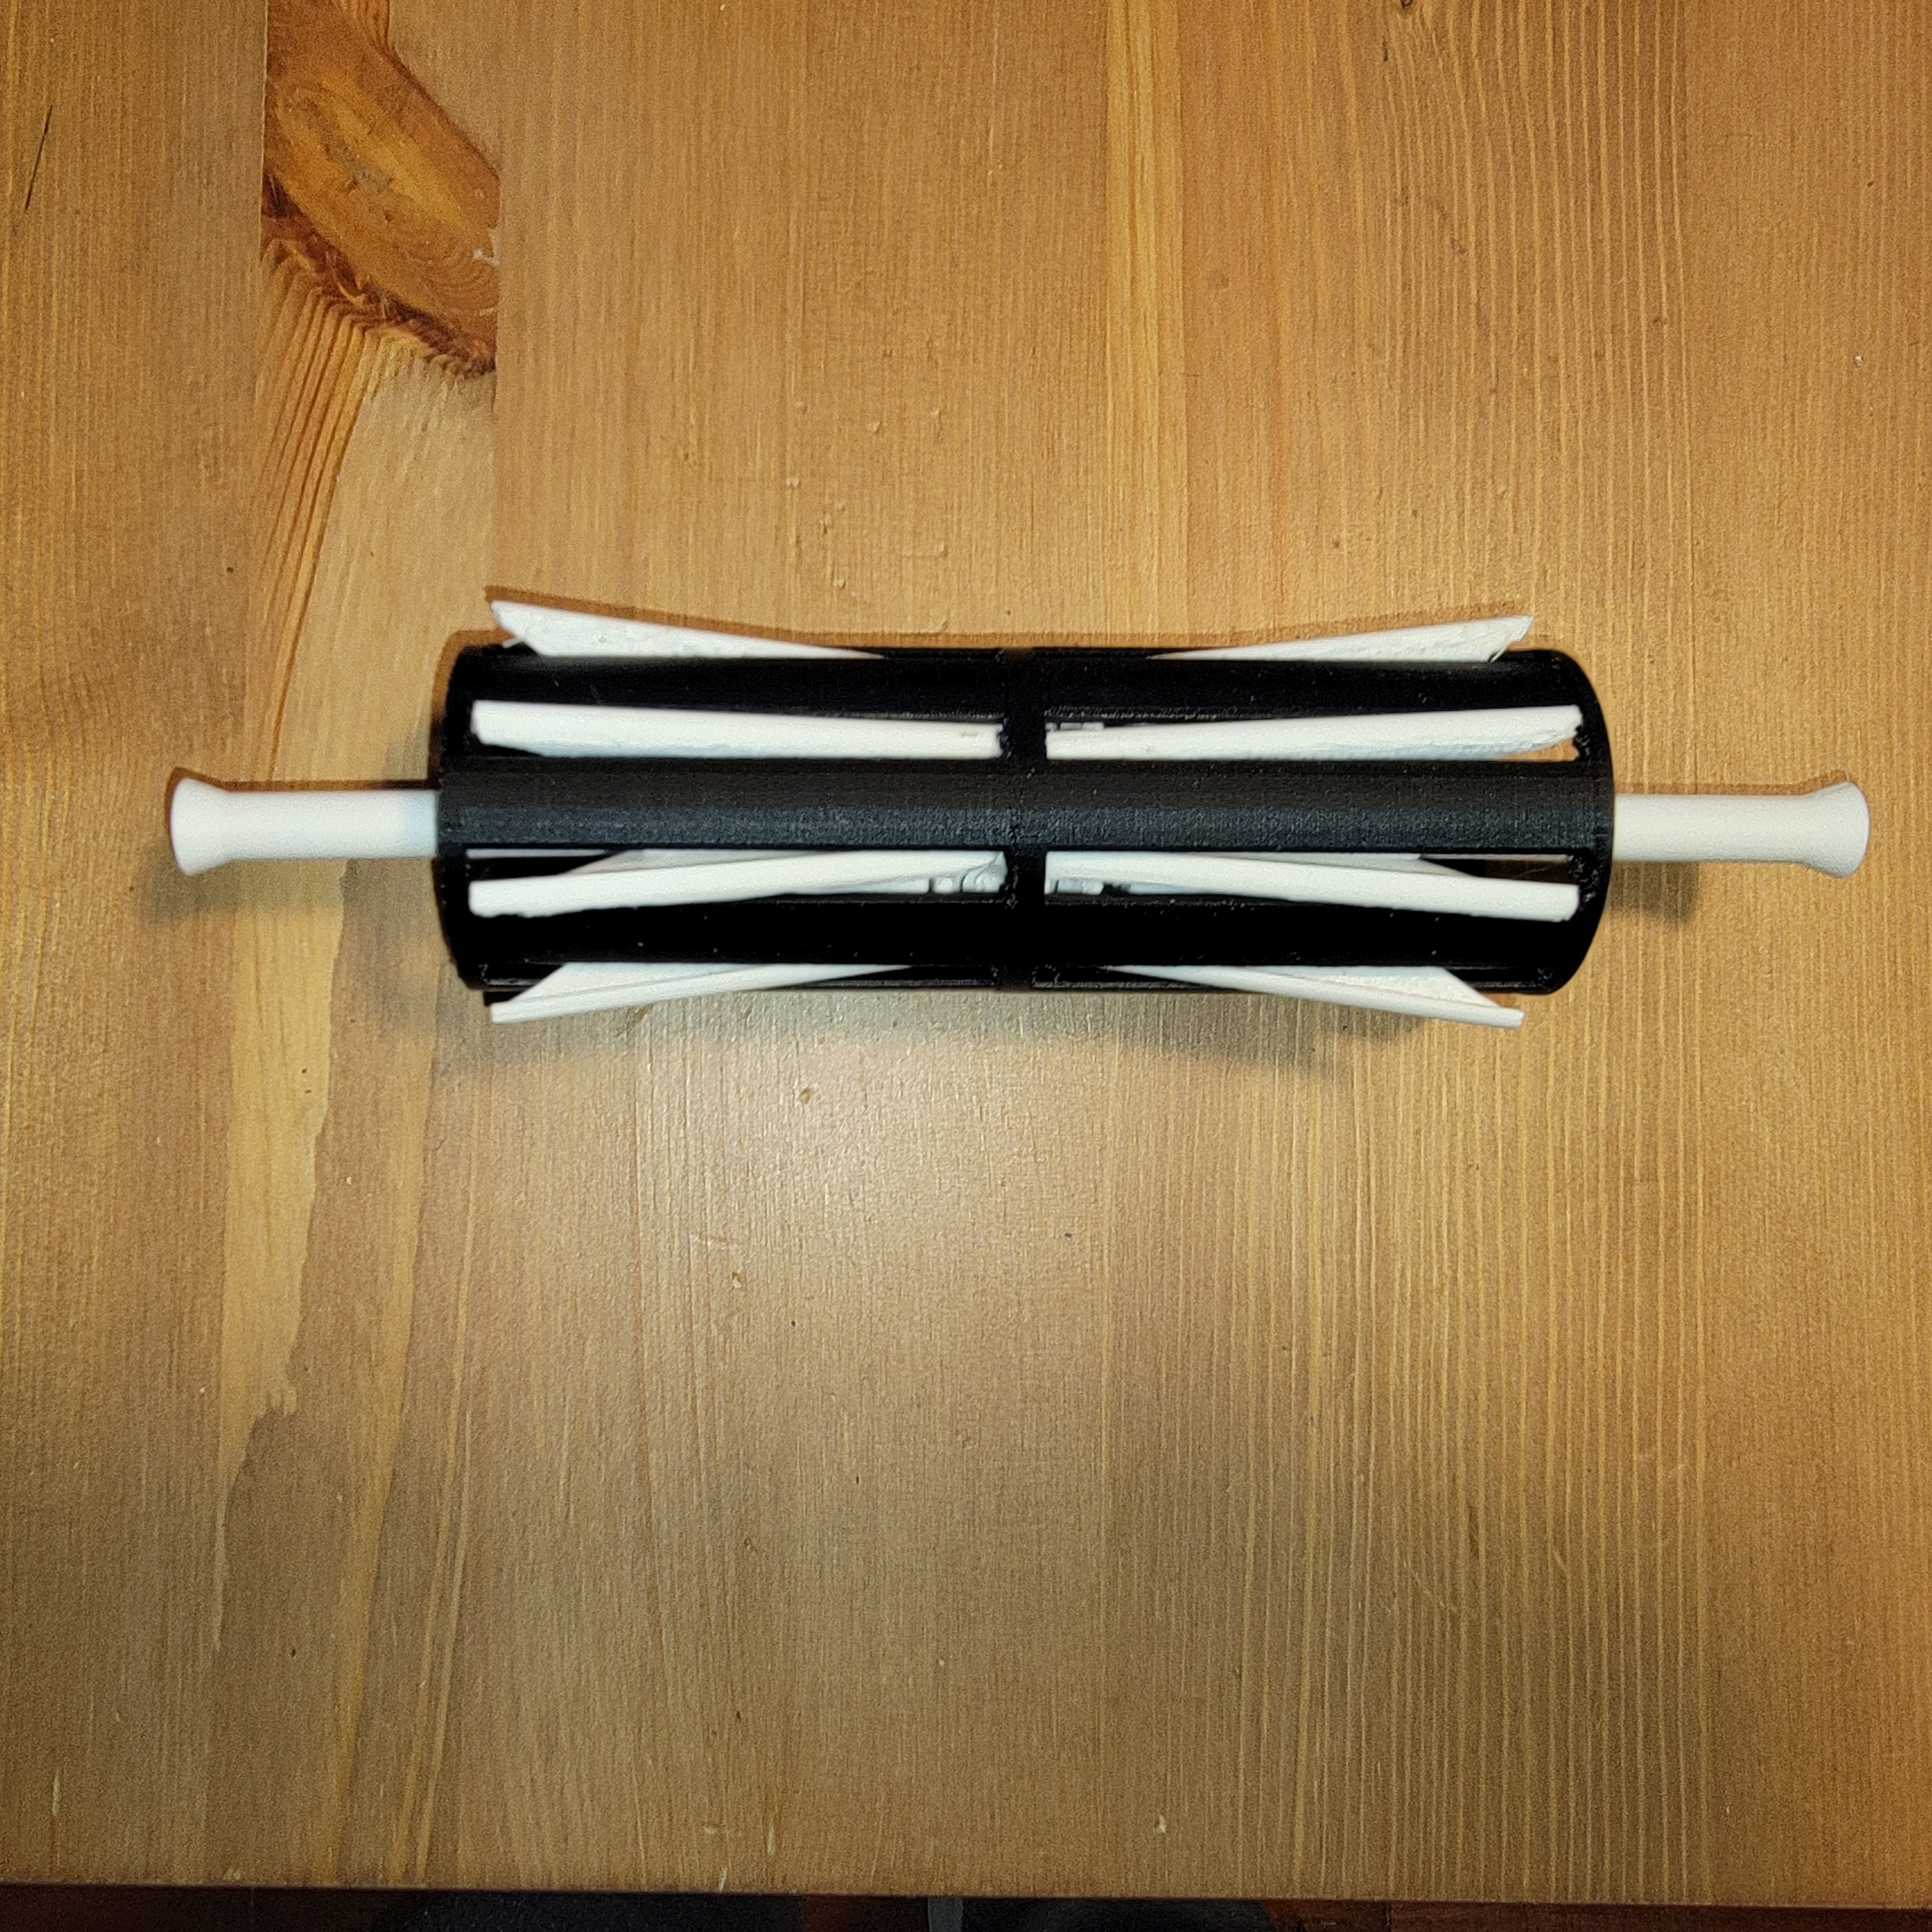
Proto Build #3
A bench-top prototype incorporates printed parts to demonstrate functionality using the barrel cam design
Fin support and slotted roller are fixed to a steel shaft. Array of fins slot onto barrel cams and are captured in an elevating raceway.
Light duty printed parts assembled around a printed internal support, surrounded by slotted roller

Slide 6
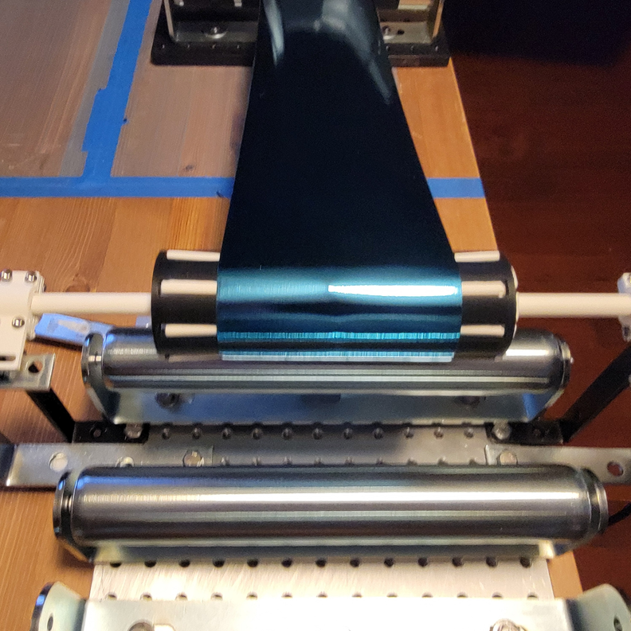
Prototype Assembly
- Rollershark_{tm} roller assembly
- Linear actuators on either side of the roller which control fin protrusion
- Drive roller utilizing anti-slip tape for traction, powered by a 250w variable speed motor
- Drive coupling & belt configured for a max roller speed of 275RPM
Shaft, Rollershark_{tm} assembly, and linear actuators are mounted on an optical test plate

Slide 7

Web Guides with Selectively Protruding Fins
Rollershark.com
Contact: Rollershark LLC
Info@rollershark.com

