Slide 1
Rollershark
Web Guides with Selectively Protruding Fins
UP Patent 12,595,147 B2

Slide 2
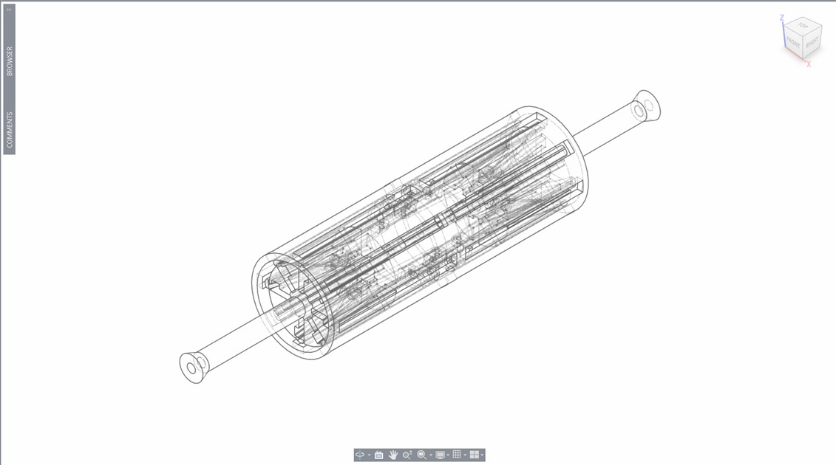
Overview
US 12,595,147 B2 covers an active web‑guiding roller system designed to automatically correct lateral misalignment in moving webs, belts, films, or sheet materials.
The system uses selectively deployable fins that extend through the roller surface to apply controlled lateral forces, improving tracking accuracy and reducing equipment wear.

Slide 3
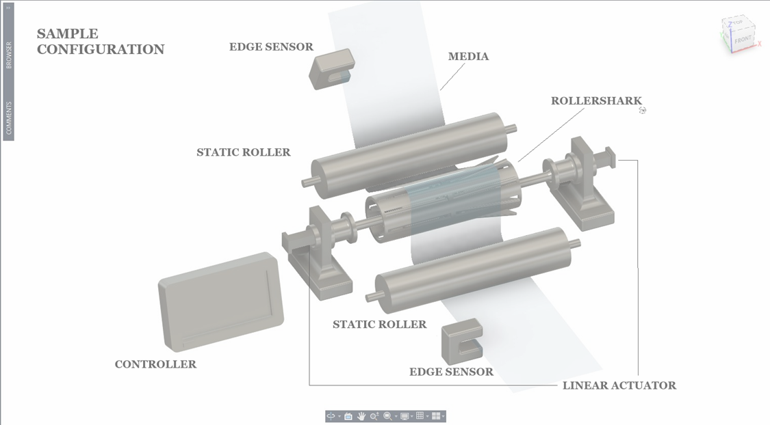
Technical Description
The patented system includes:
- A tubular roller with circumferential slots along its outer wall.
- Internal fins positioned beneath these slots, capable of extending outward to contact the moving web.
- A fin‑actuation mechanism, such as a cam or linear actuator, that controls fin extension and retraction.
- A control unit that receives input from web‑tracking sensors and adjusts fin deployment in real time.
When the web begins to drift laterally, the system extends fins on the appropriate side of the roller, applying corrective force and restoring proper alignment.

Slide 4
Key Advantages
- Active, real‑time correction of web or belt misalignment
- Reduced wear on belts, rollers, and guide components
- Fewer jams, stoppages, and misfeeds in high‑speed or heavy‑load systems
- Improved product quality in printing, coating, laminating, and film processing
- Compatible with existing conveyor and web‑handling architectures
- Scalable for light‑duty to heavier‑grade applications
Primary Applications
- Conveyor systems (warehouse, distribution, manufacturing)
- Printing presses and converting equipment
- Film, foil, and battery‑separator production lines
- Packaging and material‑handling machinery
- Airport baggage‑handling systems
- Robotics and automation systems using belt‑driven motion

Slide 5
Commercial Value
- Active, real‑time correction of web or belt misalignment
- Reduced wear on belts, rollers, and guide components
- Fewer jams, stoppages, and misfeeds in high‑speed or heavy‑load systems
- Improved product quality in printing, coating, laminating, and film processing
- Compatible with existing conveyor and web‑handling architectures
- Scalable for light‑duty to heavier‑grade applications
Status
- Patent: US 12,595,147 B2
- Title: Web Guides with Selectively Protruding Fins
- Type: Utility Patent 7 April 2026
Availability: Open for limited or exclusive licensing, acquisition
Additional: CIP, international, related applications in process

Slide 6

Web Guides with Selectively Protruding Fins
Rollershark.com
Contact: Rollershark LLC
Info@rollershark.com

